Slide 1
Upchain Server i18n
Xing Lang 2023.08.03

Slide 2
目录
What
Why
Old solution
Current solution(front-end i18n)
优点
缺点
Server i18n
优点
缺点
How

Slide 3
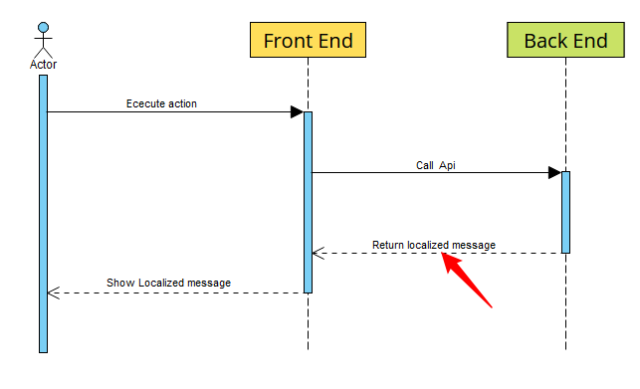
1. What is server i18n.
Back end can return localized message when front end call back-end Api.

Slide 4
2. Why
2.1 Old solution
2.2 Current solution(front-end i18n)
2.3 Server i18n

Slide 5
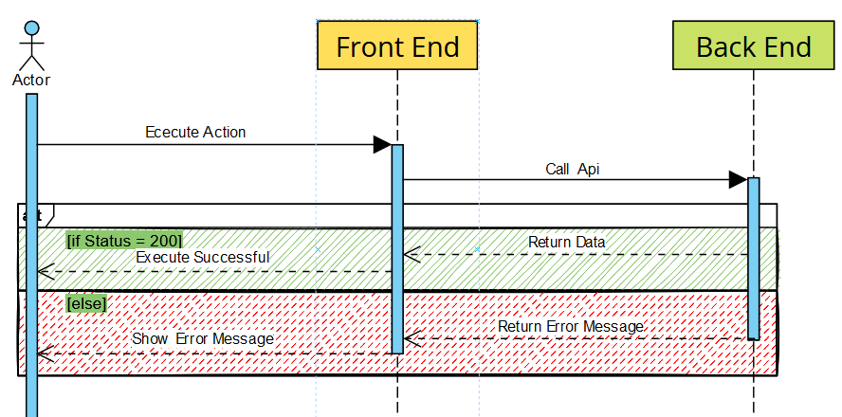
2.1 Old solution
缺点：The error message from the server is not be localized.

Slide 6
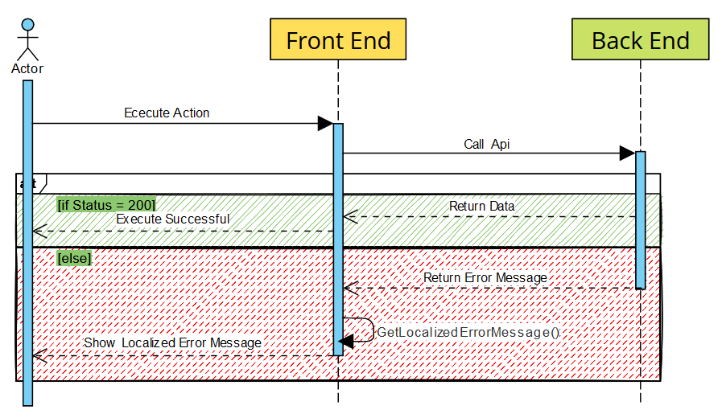
2.2 Current solution
优点: The message is localized.
缺点: 前后端强关联，不利于解耦。

Slide 7
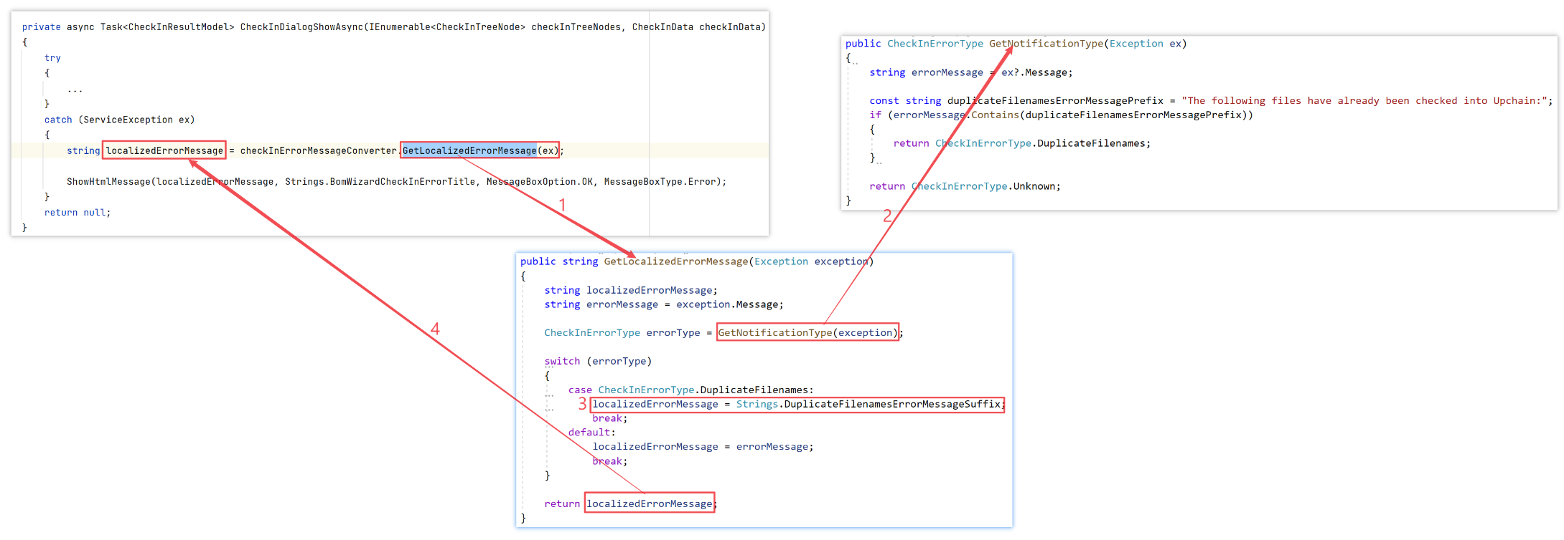
2.2 workflow
How to globalize error message from the server

Slide 8
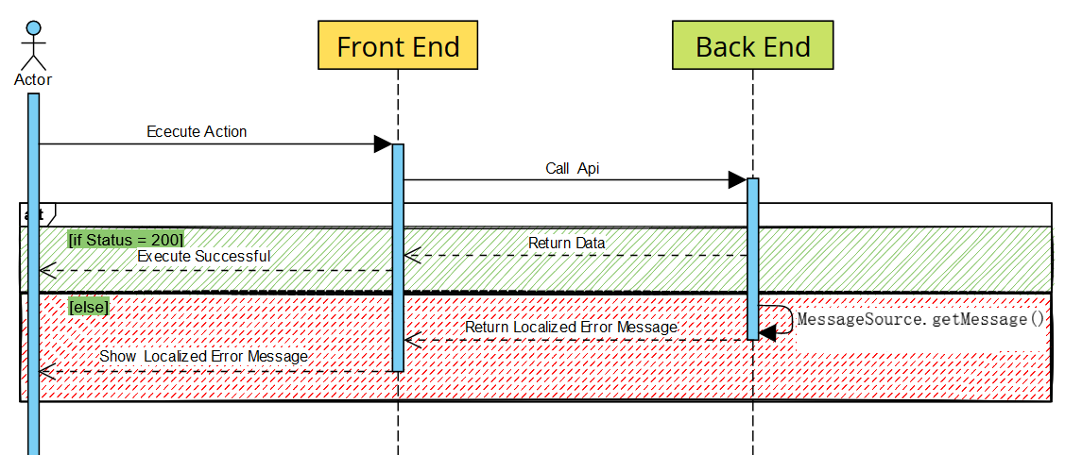
2.3 Server i18n
优点：解耦
缺点：增加后端代码的复杂度

Slide 9
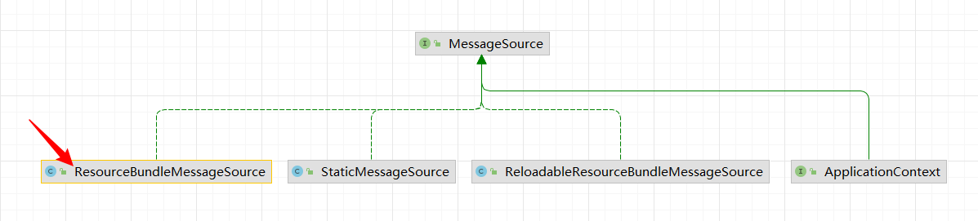
How to do the server i18n

Slide 10
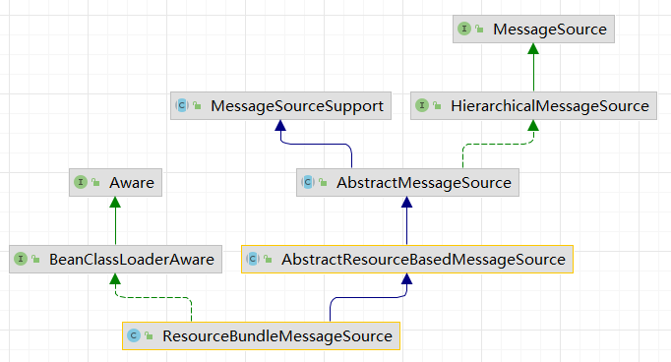
ResourceBundleMessageSource

Slide 11
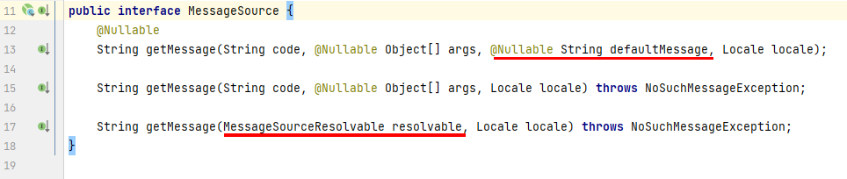
messageSource.getMessage()

Slide 12
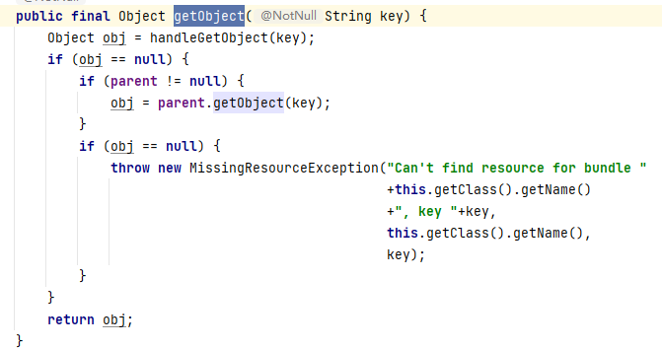
getMessage() -> getObject()

Slide 13
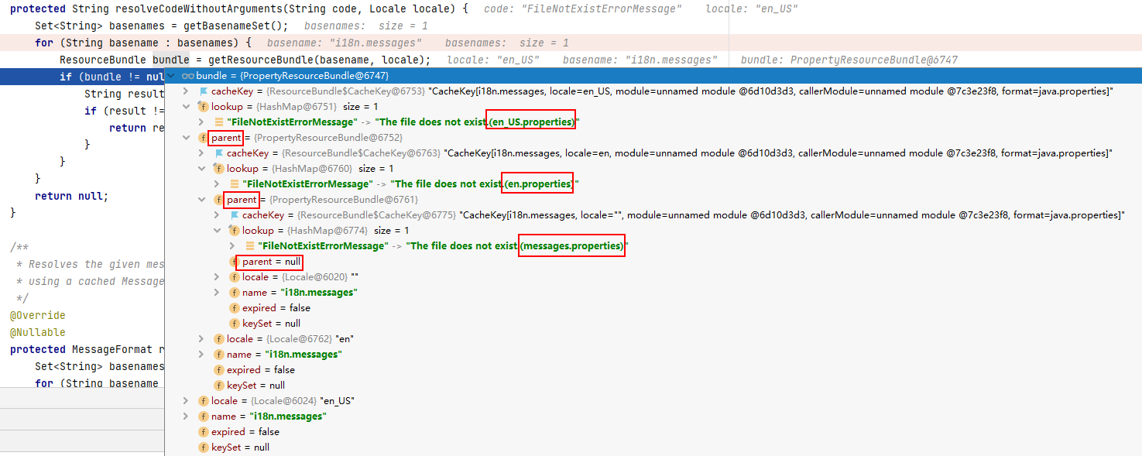
stack

Slide 14
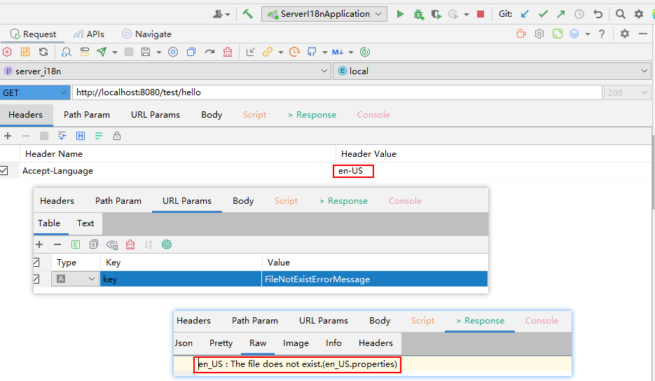
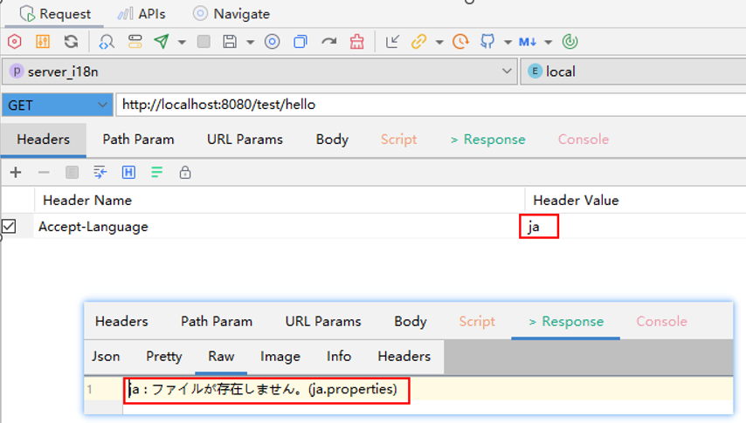
Demo

